Slide 1
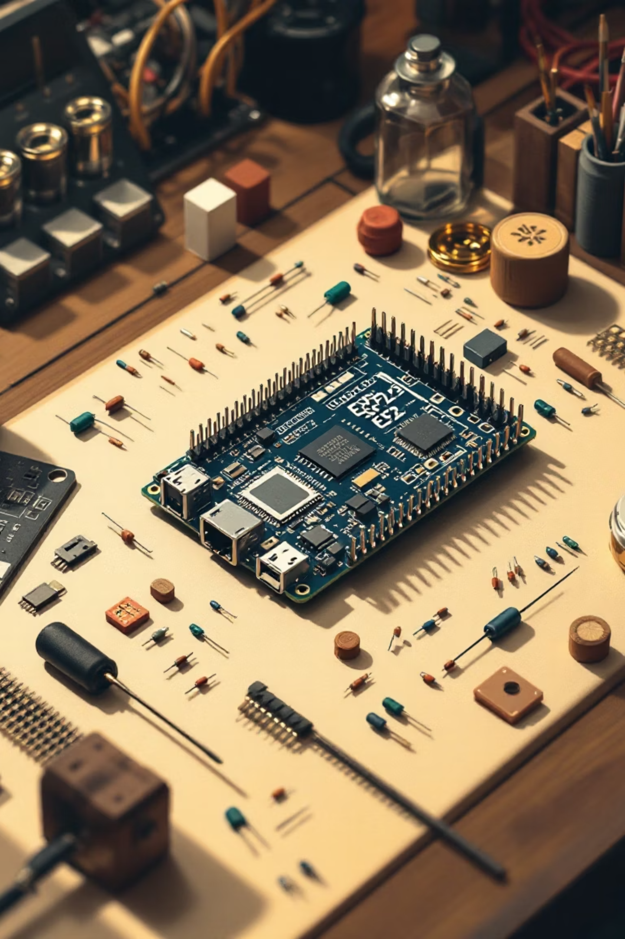
AI-Based Text-to-Speech System Using ESP32 and I2C Audio Output
Building offline, embedded voice synthesis for resource-constrained IoT applications
G. Bharat Kumar - 323129512016

Slide 2

The Challenge: Bridging the Human-Machine Communication Gap
In modern embedded and IoT ecosystems, enabling natural and intuitive interaction between humans and machines is increasingly becoming a core requirement. Speech output plays a crucial role in enhancing accessibility, improving user experience, and facilitating real-time feedback.
However, most low-power embedded systems lack an efficient, integrated method to convert text into human-like speech, limiting their potential in voice-enabled applications.

Slide 3
Limitations of Conventional TTS Solutions
Cloud Dependency
Hardware Complexity
Requires constant internet connectivity and external API services
Additional processing units increase system cost and power consumption
Privacy Concerns
Latency Issues
Sensitive data transmitted to external servers raises security risks
Network delays compromise real-time responsiveness in critical applications

Slide 4

Target Applications Demanding Local TTS
Smart Home Assistants
Voice-enabled control systems requiring instant, offline responses without cloud dependency
IoT Alert Systems
Critical notifications and warnings that must function reliably even without internet connectivity
Accessibility Devices
Assistive technologies for differently-abled individuals requiring privacy and consistent performance
Voice-Driven Automation
Industrial and commercial systems needing low-latency audio feedback for real-time operations

Slide 5

Local, Self-Contained, Offline-Capable TTS
The solution: A text-to-speech system that runs entirely on resource-constrained microcontrollers, eliminating external dependencies while maintaining high-quality audio output.

Slide 6
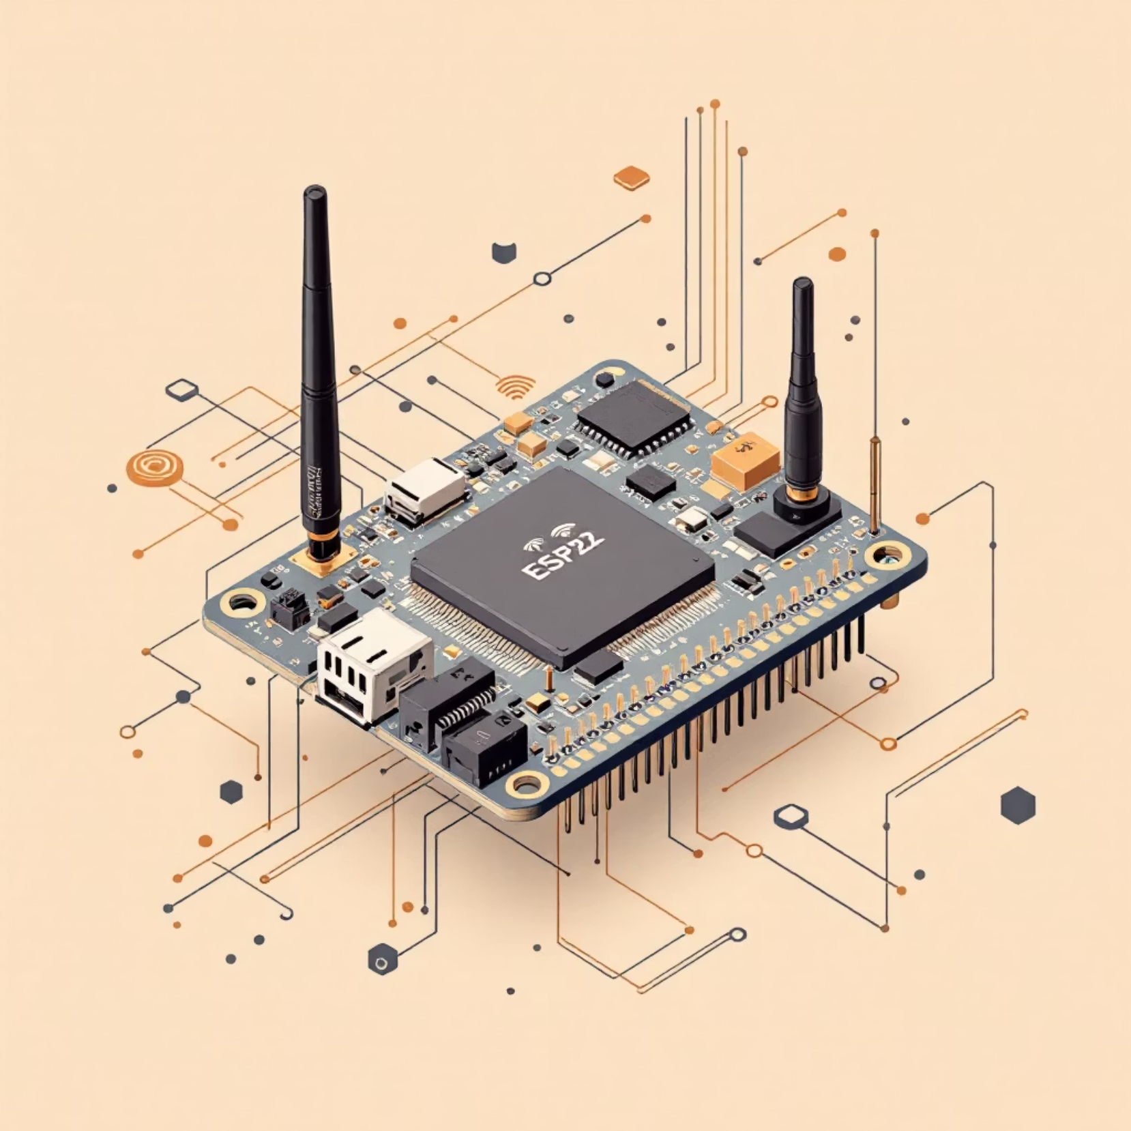
Why ESP32? The Ideal Platform
Powerful Yet Efficient
The ESP32 microcontroller provides the perfect balance of processing power, peripheral support, and energy efficiency for embedded TTS applications.
Dual-core processor for parallel task handling
Built-in Wi-Fi for network connectivity
I2S/I2C interface support for digital audio
Sufficient memory for TTS processing
Low power consumption for battery-powered devices

Slide 7





System Architecture and Data Flow
Text Input via HTTP
Local Processing
Users submit text through web interface on any Wi-Fi connected device
ESP32 processes text and generates speech entirely onboard using AI algorithms
Digital Audio Output
Audio Playback
Arduino Audio library converts to I2S/I2C signals via DAC chip
Amplified signal drives speaker for clear, audible speech output

Slide 8
Key Technical Components
ESP32 Microcontroller
I2S/I2C DAC
Audio Amplifier
Core processing unit running HTTP web server and TTS algorithms locally
Digital-to-analog converter translating binary audio data to analog signals
I2C-compatible amplification stage driving speaker at appropriate power levels

Slide 9





Implementation Benefits
Zero Latency
Privacy First
Offline Ready
Instant audio response without network delays
All data processed locally, never transmitted externally
Functions completely independent of internet connectivity
Cost Effective
Energy Efficient
No recurring API fees or expensive external hardware
Optimized for low-power, battery-operated deployments

Slide 10


Enabling Voice-First Embedded Systems
This ESP32-based TTS implementation demonstrates that sophisticated voice synthesis is achievable on resource-constrained microcontrollers without sacrificing quality, reliability, or user privacy.
The result: A self-contained, offline-capable system that empowers developers to build truly voice-enabled IoT and embedded applications with confidence.
Future potential: This architecture opens doors for multilingual support, custom voice profiles, and integration with edge AI for intelligent, context-aware speech systems.

